Slide 1

Hotel Booking App
* Guided by: Jaynam Sanghvi
* Made by:
Divyansh Singh

Slide 2


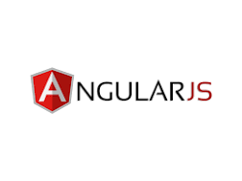
Technologies Used:
Java is a high-level, class-based, object-oriented programming language that is designed to have as few implementation dependencies as possible.
Spring Boot is an open source, microservice-based Java web framework. Spring Boot framework creates a fully production-ready environment that is completely configurable using its prebuilt code within its codebase.
AngularJS is a discontinued free and open-source JavaScript-based web framework for developing single-page applications.

Slide 3

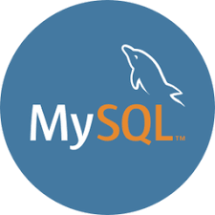

Technologies Used:
Maven is a build automation tool used primarily for Java projects. Maven can also be used to build and manage projects written in C#, Ruby, Scala, and other languages.
MySQL is an open source relational database management system. For WordPress sites, that means it helps you store all your blog posts, users, plugin information, etc.
Bootstrap is a free and open-source CSS framework directed at responsive, mobile-first front-end web development.

Slide 4

Problem Statement:
Two functional modules: Admin & User.
Guest module for location & hotel views.
User registration, user dashboard.
Location search with multiple hotel options.
Booking hotel with payment shopping.
Admin dashboard, all bookings, hotel management.
Contact us and feedback page admin managed.

Slide 5
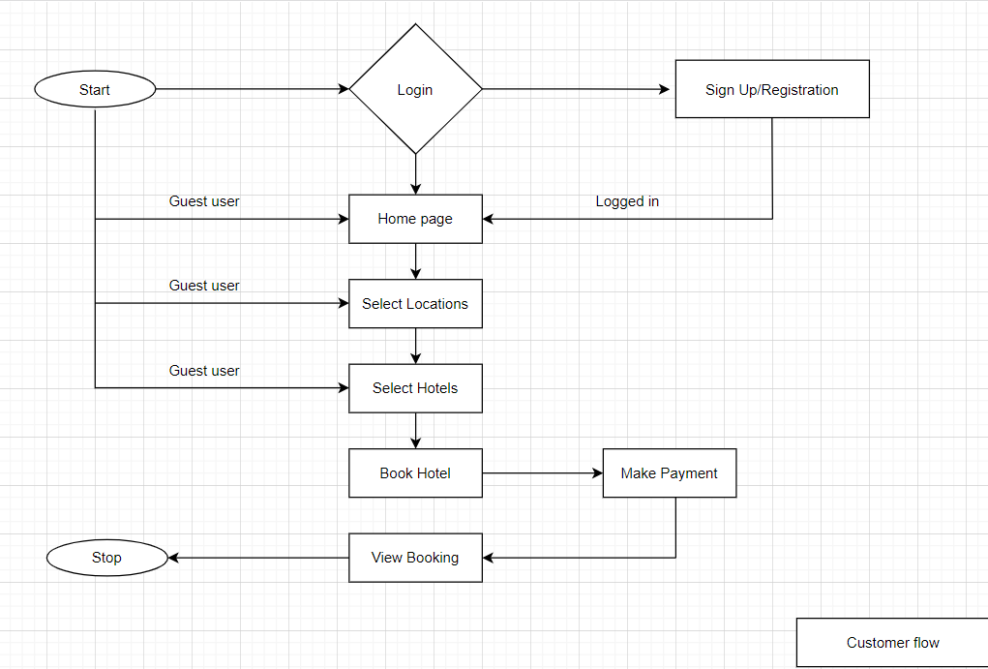
Business Plan: customer flow

Slide 6
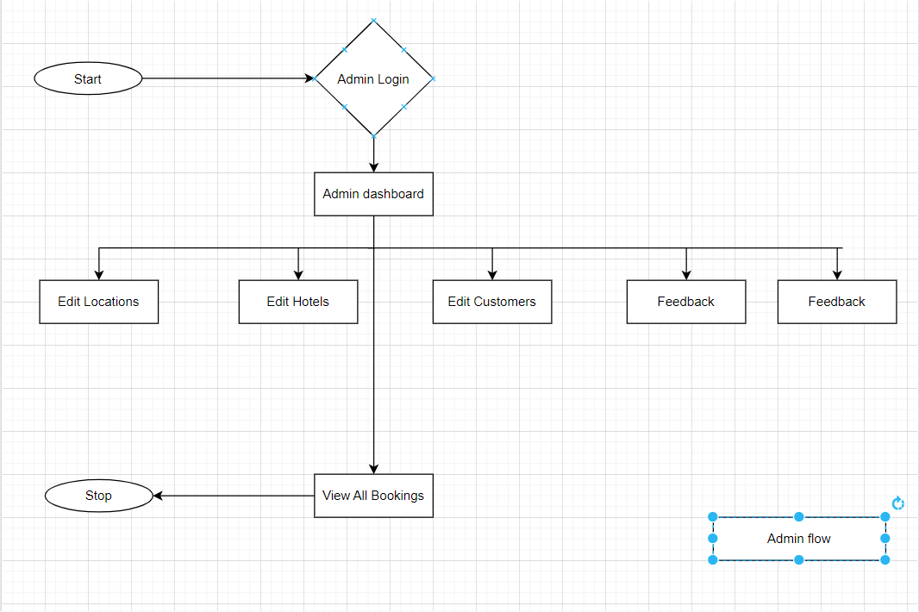
Business Plan: Admin flow

Slide 7
TDD Approach:
Test
Driven
Development
Red
Green
Refactor

Slide 8

Modules
Admin
Customer
Guest

Slide 9
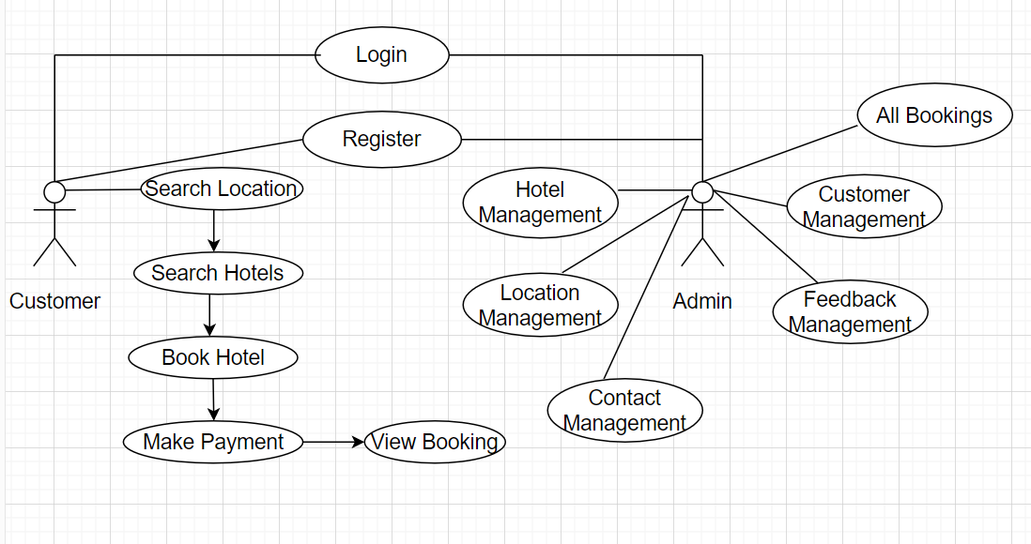
2
Use Case Diagram:

Slide 10
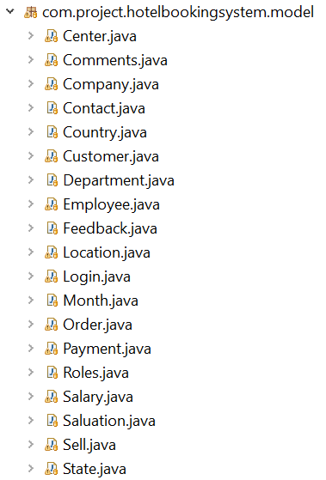
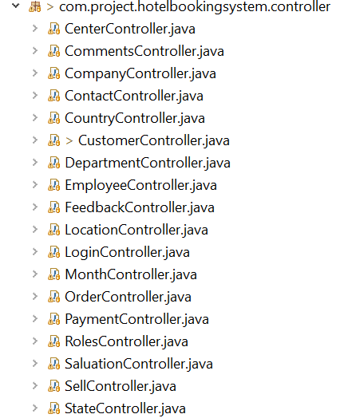
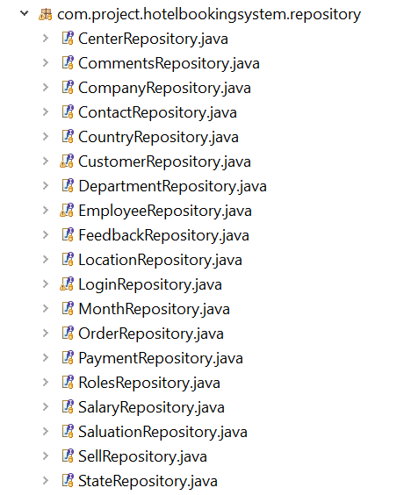
Model, Controller, Repository division:

Slide 11

Conclusion:

Slide 12

A Picture Is Worth a Thousand Words

Slide 13

Thanks
Do you have any questions?
Divyansh.Singh@yash.com
+91 7974369733
Yash Technologies

